Slide 1
Return in Principle and Practice
www.badil.org

Slide 2
Displaced Palestinians (up to 2015)
66% of the Palestinian population are forcibly displaced persons
7.98 million people total
6.14 million are 1948 refugees (5.1 registered)
1.1 million 1967 refugees
720,000 are IDPS (384,200 (Israel) + 334,600 (oPt))
Largest and longest standing refugee population in the world

Slide 3
Root Causes
Forcible Transfer
Colonization
Apartheid

Slide 4
Return in Principle
Reparations =>restoration as much as possible to what was
Voluntary Repatriation => return
Property Restitution => reclamation of original property lost
Compensation => monetary or other property
Satisfaction including guarantees of non-repetition
Notes:
According the frameworks of international law, and other international treaties on reparations

Slide 5
Return in Practice
Detailed political agreements that ensure:
Individual rights
Repealed discriminatory legislation with an enforcement mechanism
Participation of rights-holders (victims, refugees and internally displaced persons)
International support and political backing
Comprehensive legislation framework with review mechanism
A system of return and restitution grounded in the rule of law
Restitution favored over pure compensation
Notes:
An example, Bosnia – Herzegovina, What made it successful
Monetary Compensation does not give victims the sense of justice that that restitution can achieve, in other words it leaves ethnic cleansing or racial based spatial segregation in place

Slide 6
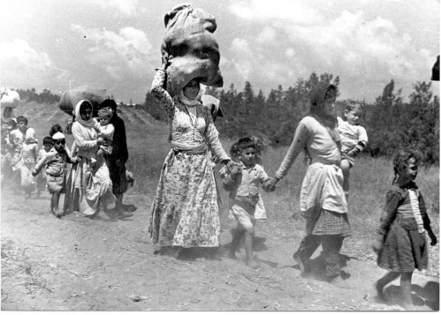
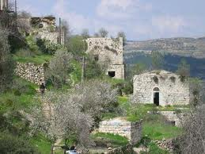
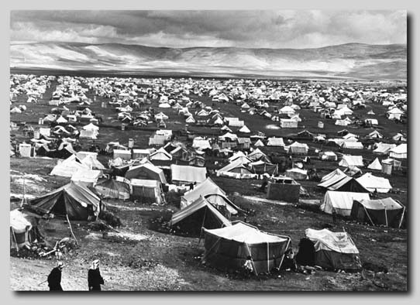
Challenges
Self-Determination
Property Restitution vs Secondary Occupants
Security and Stability

Slide 7
Self-Determination
A collective right that is a framework to facilitate other rights
Does not sanction or require the division of states
Satisfied through democratic self-government within a pre-existing territory
Never a license for artificially changing demographic composition or privileging the rights of one ethnic/religious group over another
Notes:
Israel has acquired legitimacy as a state, not as a Jewish state (Road Map 2003, UNSC Res 1515)

Slide 8
Property Restitution vs. Secondary Occupants
Palestinian refugees and IDPs as victims of a discriminatory land regime (state sponsored) have a right to restitution (from Israel)
The means by which the land was acquired is important
2˚ occupant rights would not block refugee return
Not all property rights are equal
Notes:
Where 2˚occupants were responsible for original confiscation or for racially discriminatory allocation of land it is not equitable to protect their rights over the rights of the victim (refugee or IDP)
Eg. JNF acquired a great deal of land through land sales that were even illegal under Israeli Law
Even property acquired in good faith, the 2˚ occupant is entitled to and should be the one to accept compensation, not refugee/returnee
Silman Abu Sitta: 78% of Israelis live in 14% of Israel
Remaining 86% contains 22% Israelis
20% live in Palestinian city centers (Beer Al Saba’, Ashdod, Majdal, Asqalan, Nazareth, Haifa, Acre, Tiberias and Safad
2% live in Kibbutzim
If the total refugees in Gaza and in Lebanon were to return only 1% of the Israeli Jewish population would be affected as secondary occupants
Why? Because the land is vacant/uninhabited
92% of Israelis live in urban areas
IL is most protective of residents (homes) and less protective of commercial, industrial and agricultural property
Percentage of lands that are state lands?
irrespective of the issue of good faith or legality of occupancy, the returnee/refugee has the right to re-own the individually owned property. He/she should be given the priority to decide whether or not to re-own the property. In case, returnee decides to not re-get his/her property which was occupied in good faith, the secondary occupant can remain in as an owner or tenant. As an owner with good faith,s/ he would not be asked for any contribution (for compensation purposes). As an tenant, s/he will pay rent to the owner (the returnee). However, both with or without good faith, and irrespective of whether or not the returnee deiced to re-get the property, the state is under an obligation to compensate refugees and to secure the status/conditions of secondary occupants.
Acquired rights vs legitimate rights

Slide 9
Security and Stability
Addressing the root causes:
End ongoing forcible transfer, colonization and Apartheid
Colonization in all its forms: structural, economic, political, cultural
Security and stability are important concerns in deciding how not if to implement reparation
Durable and just solution/s must be consistent with international law and the requirements of sustainable stability.
Notes:
What causes instability and insecurity? The denial of rights, which Israel has been doing from the beginning
Israeli policy of encouraging and supporting fear of the other, the common enemy
Forceful imposition of western culture and values on a geographic and social and culture of eastern orgin

Slide 10
Recommendations
Justice with stability
Rights holders participation
Reparation must be organized and systematic
Extensive reconciliation efforts
Preparation for reparations could and should begin before political agreements
Notes:
Stages of participation in the beginning it could be separate; later on after some progress we can take about unofficial and official truth commissions

Slide 11
What now?
Extensive awareness and education campaigns
Principles and Practicalities of Return
Return and restitution models
Past and present HRVs and crimes
Determine the characteristics of durable solutions and sustainable peace
Lobby and advocate for measures to end impunity and ensure accountability
Notes:
Characteristics: of the state, of restitution mechanisms, of the law/legislation
This includes investigation, prosecution and punishment of perpetrators
Prosecution (Eg under universal jurisdiction) is a form of reparation and can ensure deterrence and non-reoccurence of HRVs and crimes and restore relations

Slide 12
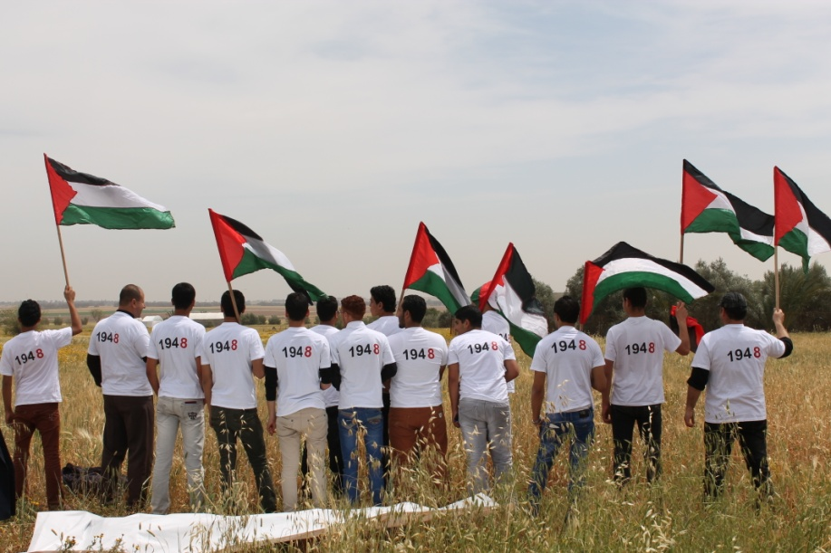
Questions??
Return is Our Right
and Our Will

